Slide 1
Architecture Constraints
Software Architecture

Slide 2
Architecture Constraints
Constraints | Background and/or motivation
Memory friendly | Memory can be limited (due to availability on a shared host or deployment to cloud based host). If deployed to a cloud based solution, every megabyte of memory costs this especially effects us due to us being a startup and not well funded as of now.
Deployable to a Linux server | Linux is suitable for industries that require customization, flexibility, and low cost which we would prefer in the early stages of our project.
Third party software must be available (PIXLR) | Third party services libraries have their own requirements and limitations. Furthermore licensing is key with these services, however it has to be confirmed that the used filters fulfill our requirements and guidelines
Data and Privacy regulations (EU,USA and China) | Due to the large amount of data stored from the various user some guidelines need to be upheld for the safety of our users as well as protection from legal repercussions.
Budget requirements | As a startup we only have a small budget (100 000EUR).

Slide 3
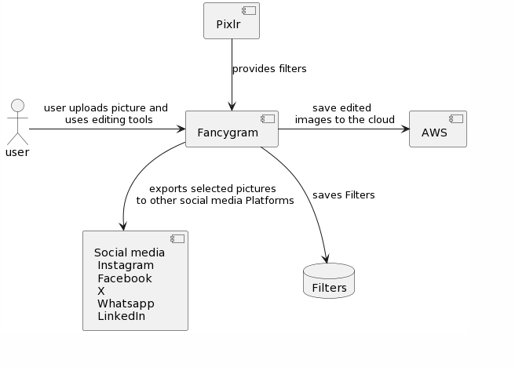
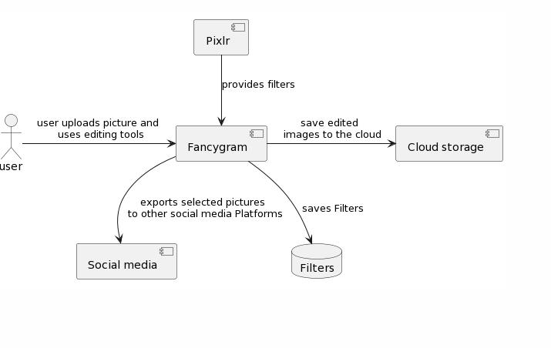
Business Context

